Slide 1
Unveiling Fake News: A Comprehensive Analysis

Slide 2
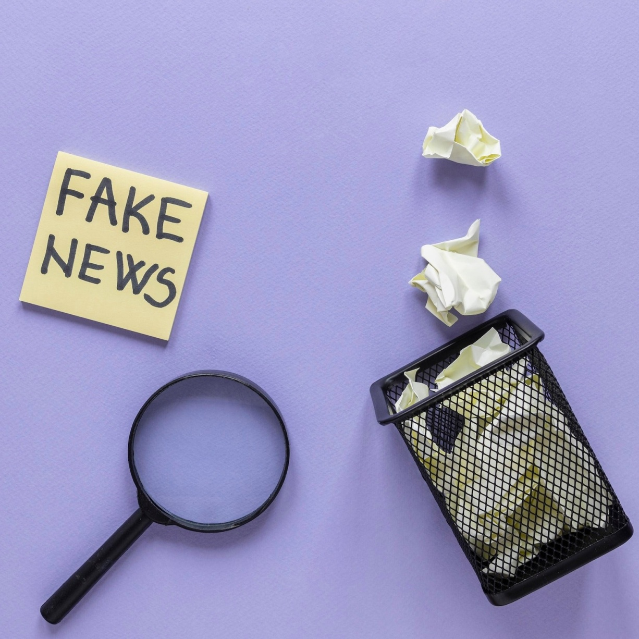
Introduction
Understanding the impact of fake news on society. Exploring the sources and spread of misinformation. Analyzing the consequences of fake news on public opinion and decision-making.

Slide 3
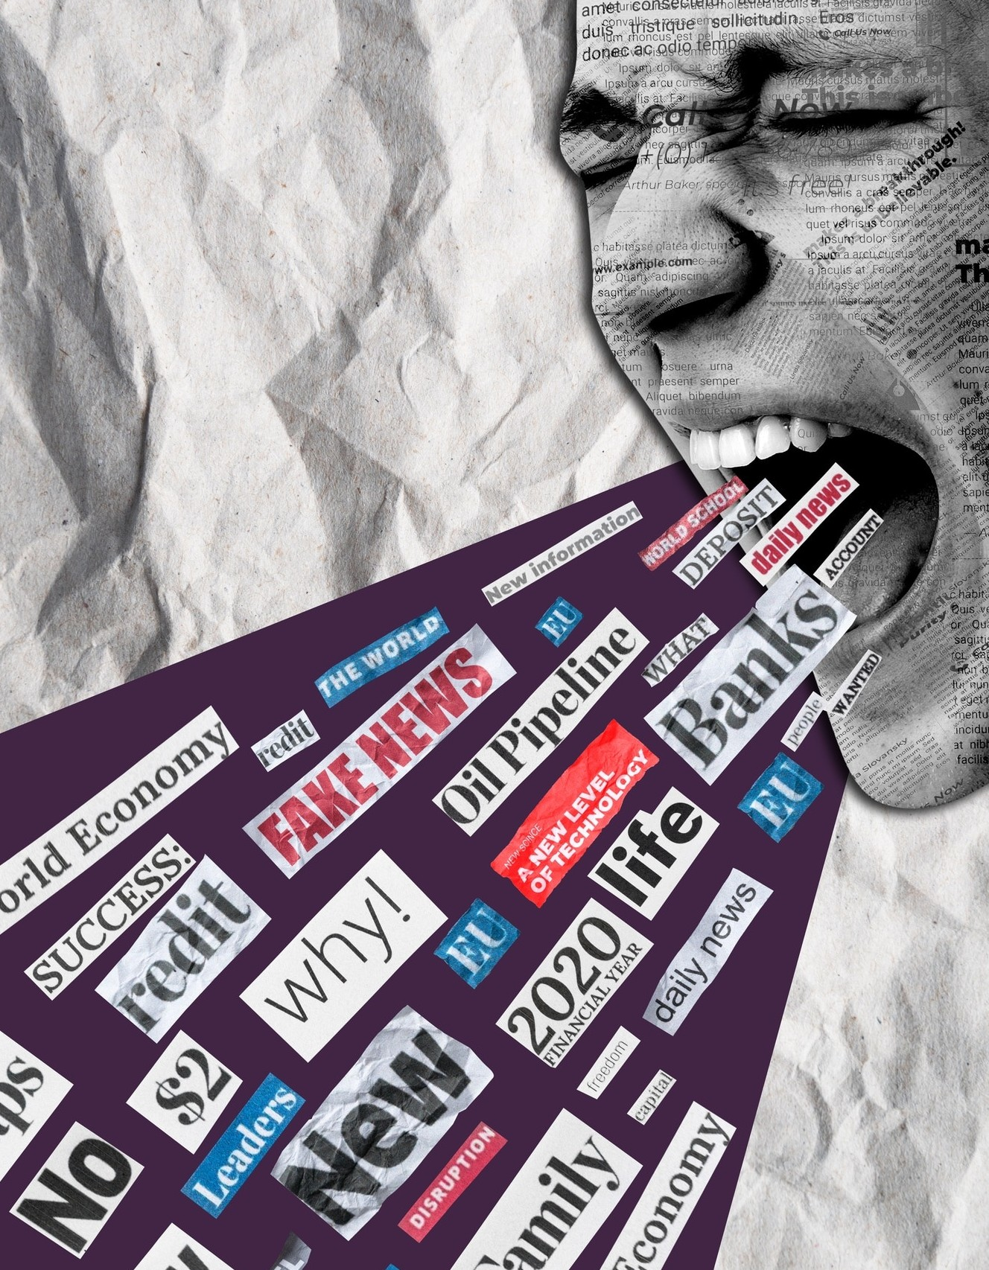
Deﬁning Fake News
Distinguishing between misinformation and disinformation. Examining the role of conﬁrmation bias in fake news consumption. Identifying the characteristics of fake news content.

Slide 4
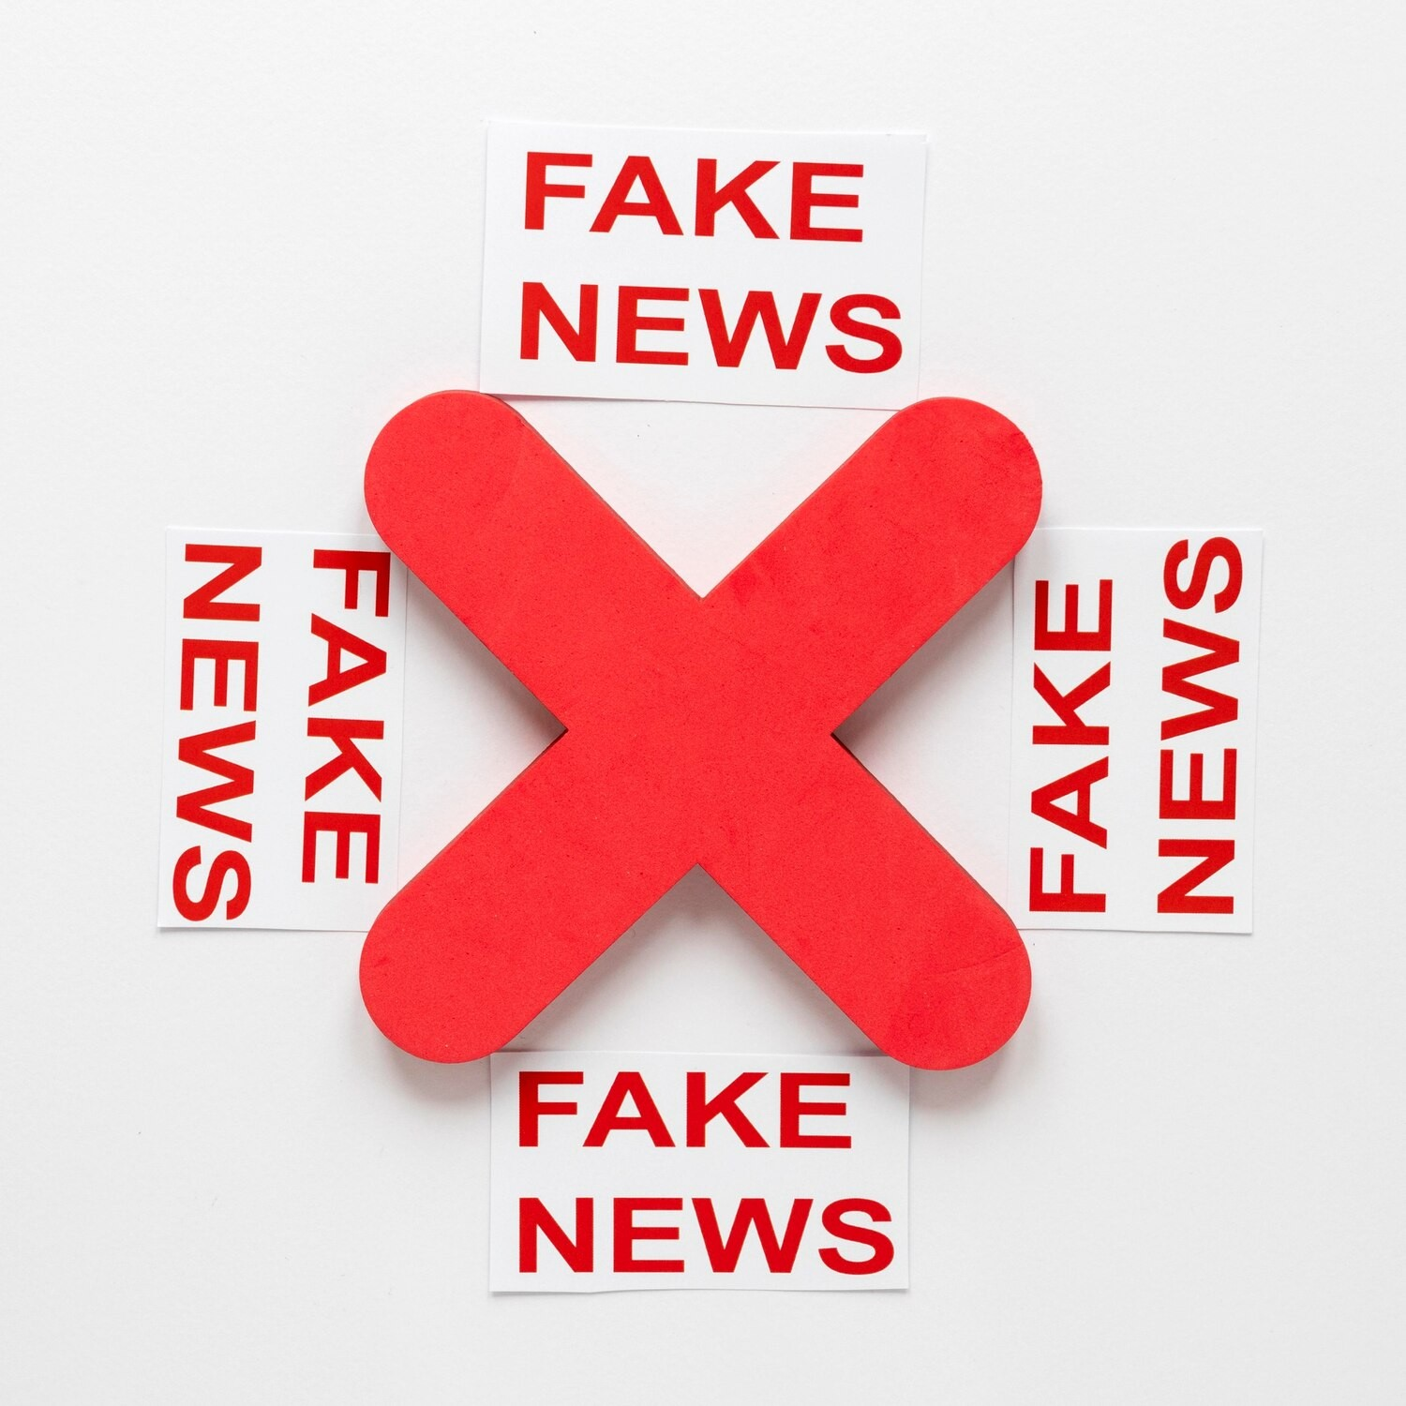
Social Media's Role
Exploring the ampliﬁcation of fake news on social media platforms. Investigating the algorithmic spread of misinformation. Analyzing the challenges of regulating fake news on social media.

Slide 5

Psychological Impacts
Understanding the psychological vulnerabilities exploited by fake news. Examining the emotional manipulation tactics used in misinformation. Analyzing the long-term effects on public trust and mental well-being.

Slide 6

Fact-Checking Strategies
Highlighting the importance of verifying sources and cross-referencing information. Exploring fact-checking organizations and their methodologies. Discussing the effectiveness of fact-checking in combating fake news.

Slide 7

Examining the limitations of legal frameworks in addressing fake news. Discussing the ethical implications of combating misinformation. Analyzing the balance between freedom of speech and the regulation of fake news.

Slide 8
Case Studies
Analyzing real-world examples of the impact of fake news. Examining the repercussions of misinformation on elections, public health, and social movements. Identifying lessons learned from past incidents.

Slide 9

Media Literacy Initiatives
Exploring educational programs aimed at enhancing media literacy. Discussing the role of critical thinking in combating fake news. Analyzing the effectiveness of media literacy initiatives.

Slide 10
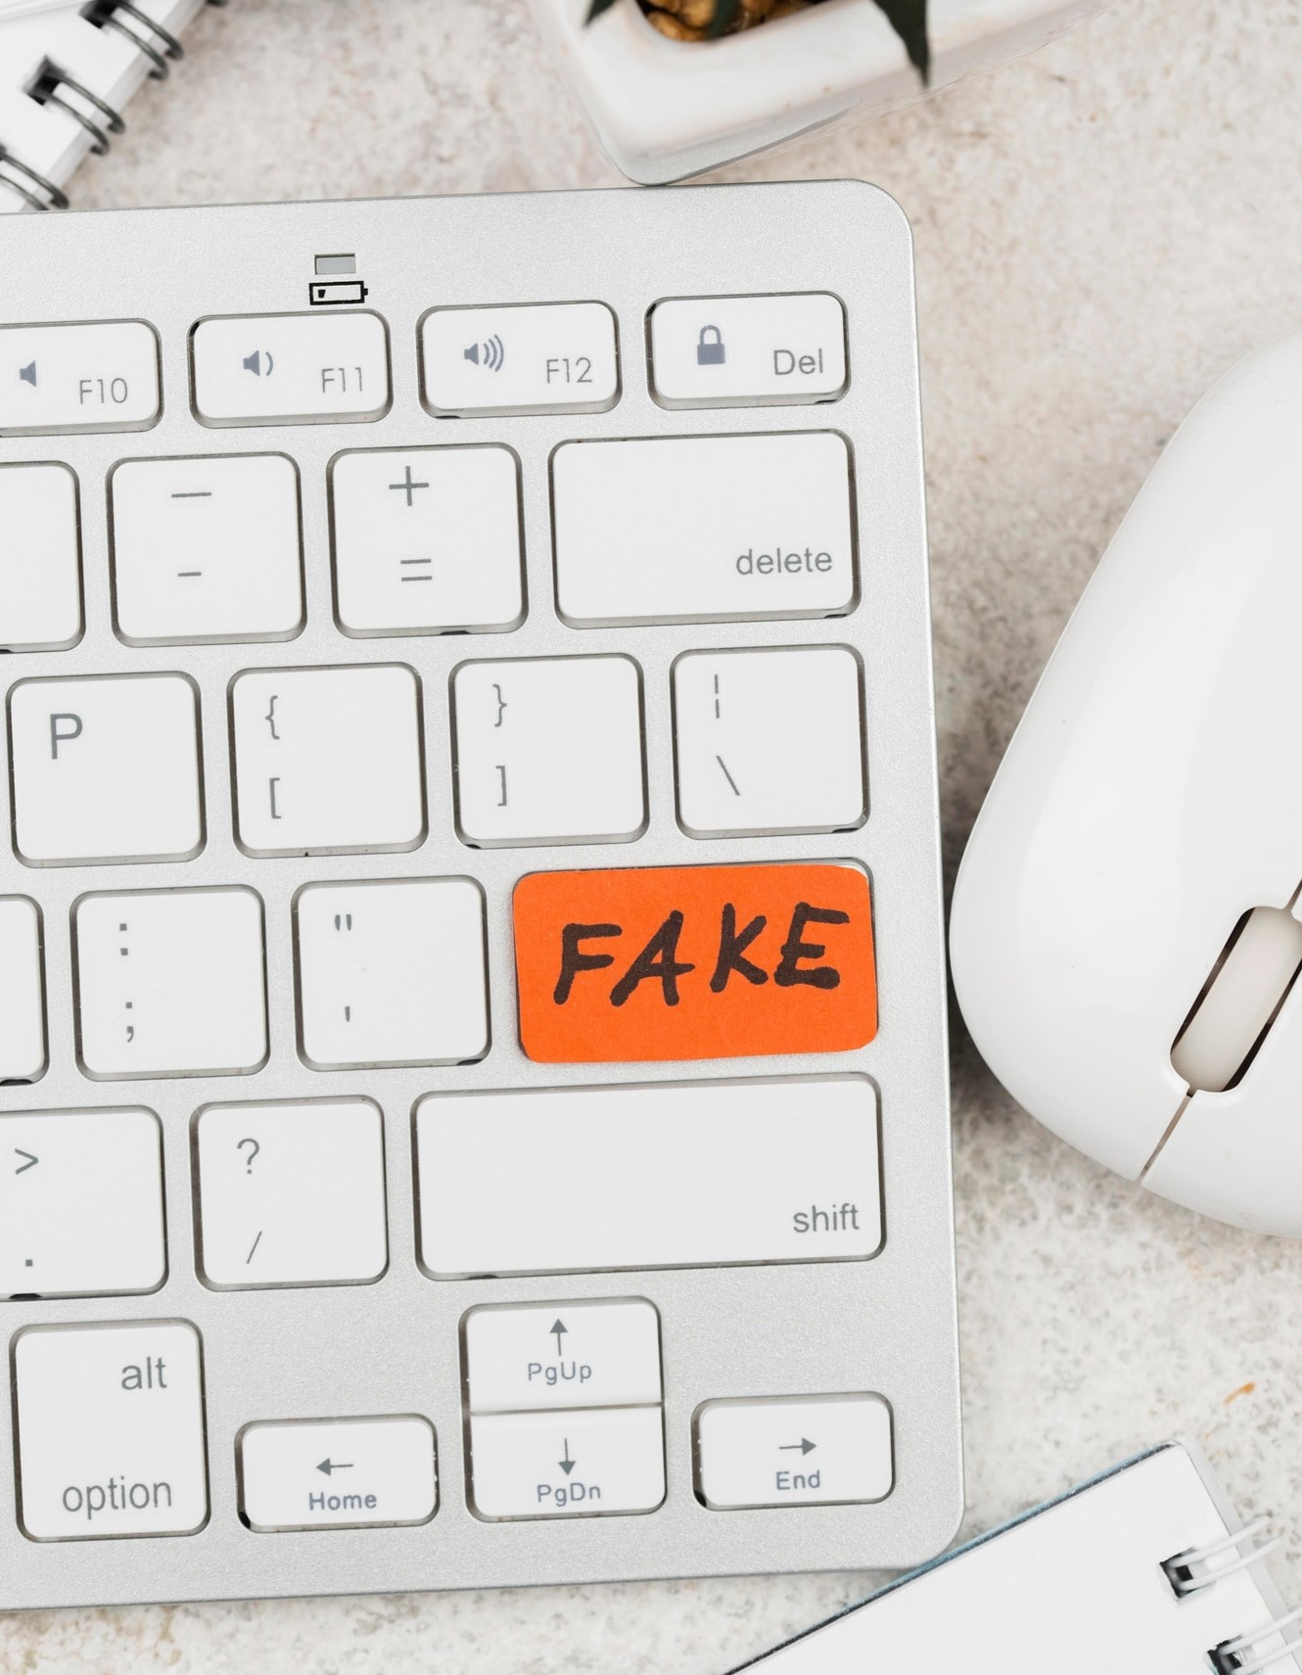
Technological Solutions
Examining technological tools designed to detect and ﬂag fake news. Exploring the use of AI and machine learning in identifying misinformation. Analyzing the limitations and potential of technological solutions.

Slide 11

Global Impact
Assessing the worldwide implications of fake news on democracy and governance. Analyzing the cross-border spread of misinformation. Exploring international efforts to address fake news.

Slide 12

Future Challenges
Anticipating the evolution of fake news in the digital age. Discussing the emergence of deepfakes and AI-generated misinformation. Analyzing the ongoing battle against fake news.

Slide 13

Conclusion
Summarizing the key ﬁndings and insights on fake news. Emphasizing the need for collective action to combat misinformation. Encouraging critical thinking and media literacy as essential tools in the ﬁght against fake news.

Slide 14
Thanks!

